Slide 1

After a long career in journalism and publishing, Chris Anderson became the curator of the TED Conference in 2002 and has developed it as a platform for identifying and disseminating ideas worth spreading.
Chris Anderson
Curator of the TED

Slide 2
Not everyone is born as a natural public speaker.
I certainly wasn’t.
But, I am convinced that everyone can learn
enough to communicate effectively
and it’s worthwhile doing so
Bharat
mane
Notes:
https://www.udemy.com/chris-anderson-on-public-speaking/
Chris Anderson

Slide 3

a journey
Bharat
mane
Notes:
So a great way to think about "a talk" is as a journey. You, the speaker, are going with your audience on a journey of discovery together.
So what makes a journey successful?
It's really just two simple things.
The first is you obviously have to start where the audience is.
You start on the journey together. So that means you have to be putting yourself in their shoes and planning to use their language, their assumptions, not your own starting assumptions.
And then each step of the journey needs to be both possible and desirable.

Slide 4
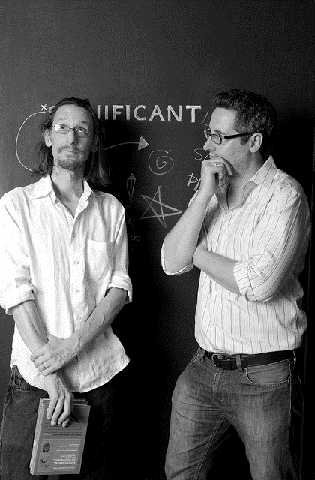

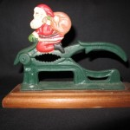

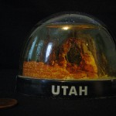





eBay Project
Significant Objects, a literary and anthropological experiment devised by Rob Walker and Joshua Glenn, demonstrated that the effect of narrative on any given object’s subjective value can be measured objectively
Rob Walker (L) and Joshua Glenn
https://significantobjects.com/
Bharat
mane

Slide 5
$ 129
$ 8000
Bharat
mane
Notes:
The cost of a poor PowerPoint presentation is staggering. Ian Parker in The New Yorkermagazine states that according to Microsoft estimates, there are more than 30 million PowerPoint presentations made each day. If we assume some relatively conservative meeting parameters of four people per presentation, a half-hour presentation on average and the wasted time due to a poor presentation is one-quarter of the presentation time, we arrive at a waste of 15 million person hours per day. At an average salary of $35,000 per year for those attending the meeting, the cost of that wasted time is a staggering $252 million and change each day.soft estimates, there are more than 30 million PowerPoint presentations made each day.

Slide 6

What doesn’t work
The sales pitch
The ramble
ORG BORE
Inspiration perfromance
Bharat
mane
Notes:
The first is the ramble.
So many speakers think that they can just come and wing it.
They come under-prepared to a speaking occasion and they
just talk about one thing that's on
their mind and then they shift to another and they go,
oh, yes, and another thing that I just must mention before I stop
is and the audience doesn't know where they are heading.
There's no connection between these different parts.
The speaker may think that, hey,
all of this is interesting,
I'm an interesting person,
look at me, the audience experience is just one of deep frustration. Don't ramble.
You owe it to our audience to prepare a connected talk.

